Slide 1

Crime Victims’ Rights in Ohio Post-H.B. 343 & S.B. 16
The Current Legal Landscape for Ohio’s Crime Victims

Slide 2
About Us
Ohio Crime Victim Justice Center is a statewide 501(c)(3) nonprofit organization founded to help ensure that the constitutional and statutory rights of Ohio’s state and federal victims of crime are upheld throughout the criminal justice process.

Slide 3
Our Services
Direct representation
Training
Legal advice and assistance for professionals
Referrals
Victims’ Rights Toolkit

Slide 4
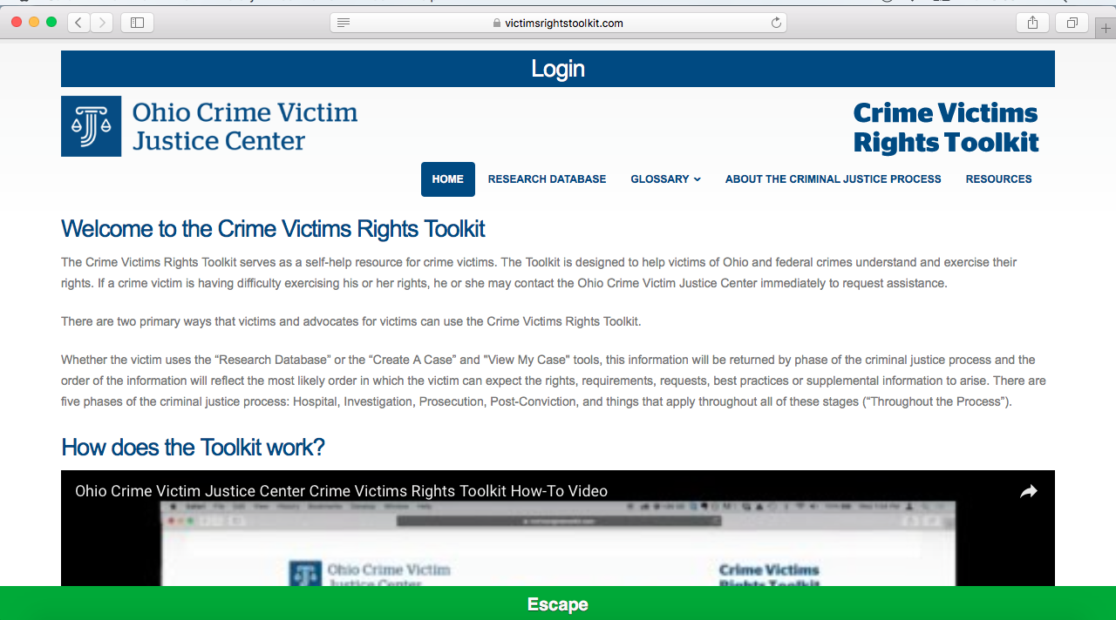
Victims’ Rights Toolkit (victimsrightstoolkit.org)

Slide 5
Who is a victim?

Slide 6
Ohio Constitution, Article I, Section 10a(D)
Marsy’s Law and R.C. 2930.01 expand the legal definition of victim to protect the person against whom the criminal offense or delinquent act was committed and/or the person directly and proximately harmed by the criminal offense or delinquent act.

Slide 7
Victim Definition Case Law
Who IS NOT a victim?
  A municipality
    City of Centerville v. Knab, 2020-Ohio-5219.
  The victims’ compensation fund
    State v. Johnson, 2021-Ohio-1869 (3rd Dist.).
Who IS a victim?
  A car owner not listed in an indictment
    State v. Morales, 2023-Ohio-2459 (1st Dist.).
  A law firm
    State v. Crosby, 2024-Ohio-2877 (1st Dist.).
  Parents, children, and siblings of a deceased victim
    State v. Anderson, 2025-Ohio-1226 (5th Dist.).
Pending case
  State ex rel. Gatehouse Media Ohio Holdings II, Inc. d/b/a The Columbus Dispatch v. The City of Columbus Police Department, Case No. 2023-1327 (Ohio Supreme Court)

Slide 8
What are a victim’s rights?

Slide 9
Ohio Constitution, Article I, Section 10a(A)(1)
Right to be treated with fairness and respect for:
Safety
Dignity
Privacy

Slide 10
Right to Protection: Ohio Constitution, Article I, Section 10a(A)(4)
Marsy’s Law provides victims with the right to reasonable protection from the accused and those acting on behalf of the accused.

Slide 11
Privacy
State ex rel. Summers v. Fox, 2020-Ohio-5585.
  Victim privacy rights do not shield public records containing victim names and identifying information from release.
  But the legislature addressed this privacy concern with R.C. 2930.07.
    “...That public office or public official shall take measures to prevent the public disclosure of the name, address, or other identifying information of the victim or victim's representative through the use of redaction...”
Savransky v. Mahoning Cty. Prosecutor's Office, 2023-Ohio-3089 (7th Dist.).
  Holding that R.C. 2930.07(C) cannot be applied to justify redactions made before its effective date because it would be contrary to public records precedent that the resolution is based on the version of R.C. 149.43 in effect when the underlying request was made, and the current statute does not clearly indicate that it should be applied retroactively.
State ex rel. Curtis v. Turner, 2024-Ohio-2682.
  A clerk was correct to redact victim identifying information from public record prior to public release.

Slide 12
Safety, Reasonable Protection, and Dignity
State v. Beach, 2021-Ohio-4497 (10th Dist.)
  A victim’s right to be treated with fairness and respect for her safety and dignity and a victim’s right to reasonable protection from the accused was implicated in blood testing of a defendant following a physical assault.

Slide 13
Right to Effective Communication:
RC 2930.041
Victims with disabilities have the right to a free registered or certified American Sign Language interpreter on the registry for interpreters for the deaf at the following times:
  All court proceedings
  All prosecutor meetings
  All investigative contacts with LE
  All contacts with probation, DRC, and DYS

Slide 14
Right to Effective Communication:
RC 2930.041
Victims who are non-English speaking or limited English proficient have the right to a free certified, provisional, registered, or language skilled foreign language interpreter at the following times:
  All court proceedings
  All prosecutor meetings
  All investigative contacts with LE
    Exception: LE may use technology assisted interpretation services in the field if interpreters are not reasonably available
  All contacts with probation, DRC, and DYS
Interpretation services guaranteed under this section are subject to availability but not cost

Slide 15

Investigation
Phases of the Criminal Justice Process

Slide 16
The Victims’ Rights Request Form
How the form is created, its format, and who gets it when

Slide 17
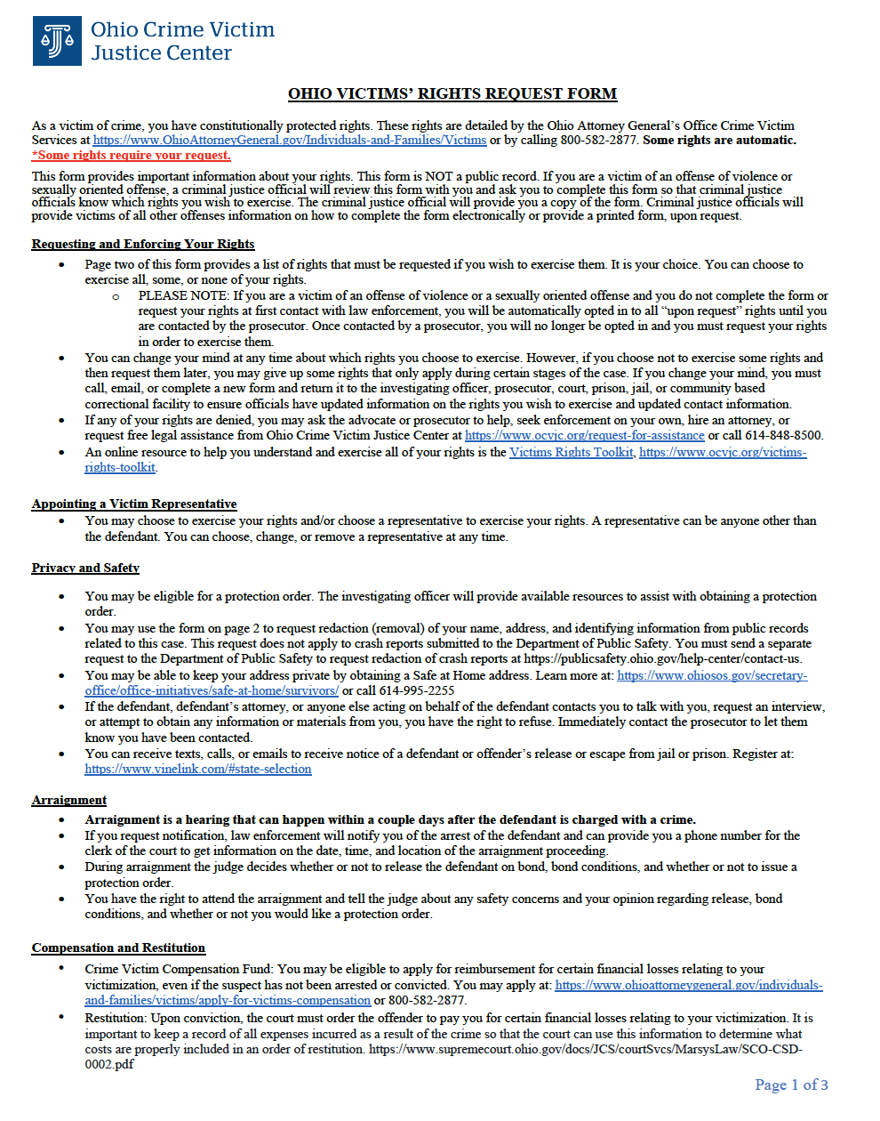
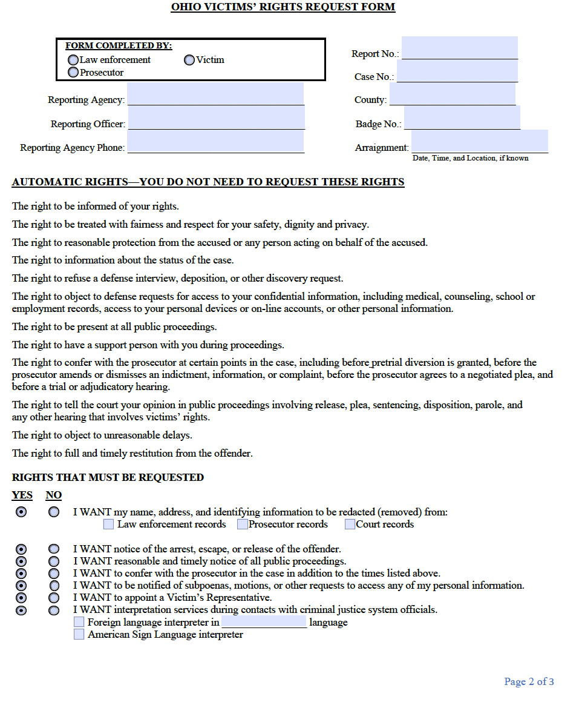
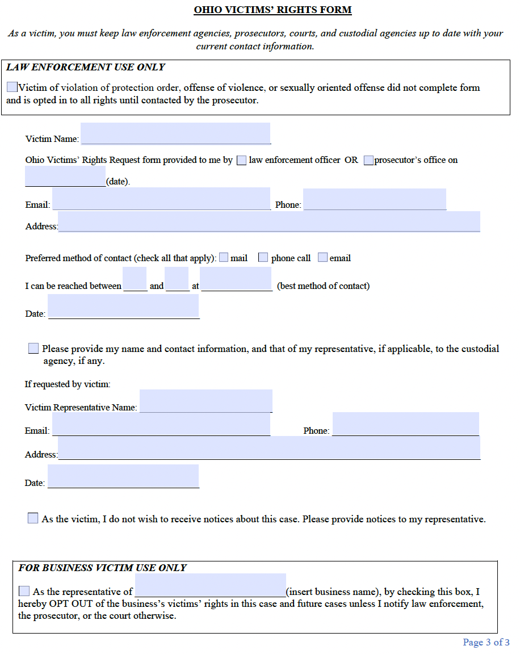

Slide 18
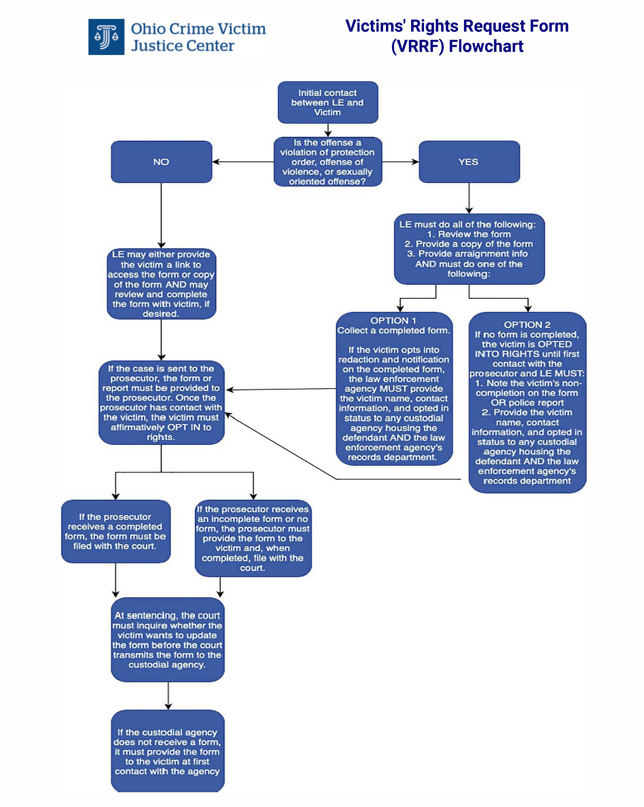

Slide 19
Victims’ Rights Request Form: RC 2930.04
The Attorney General’s office must create and provide access to a Victims’ Rights Request Form, as well as an online compilation of victims’ rights and resources
CJ officials may use the AG’s form or create their own
The form may be used written or electronic
format
The form will be available in English, Spanish, and Arabic, and other languages upon request

Slide 20
Right to be Informed: RC 2930.042
Victims are entitled to notifications if felony cold/inactive cases are closed or reopened

Slide 21
Right to be Informed: RC 2930.05
Within reasonable time after arrest, a victim has a right to notice of:
  Arrest of defendant
  Defendant name
  That defendant may be eligible for release
  Phone number of LE
  Right to call custodial agency to request notice of release
  Right to notice of terms of pretrial release
  Information about arraignment
  Pick up radius of law enforcement agency if defendant is picked up elsewhere

Slide 22
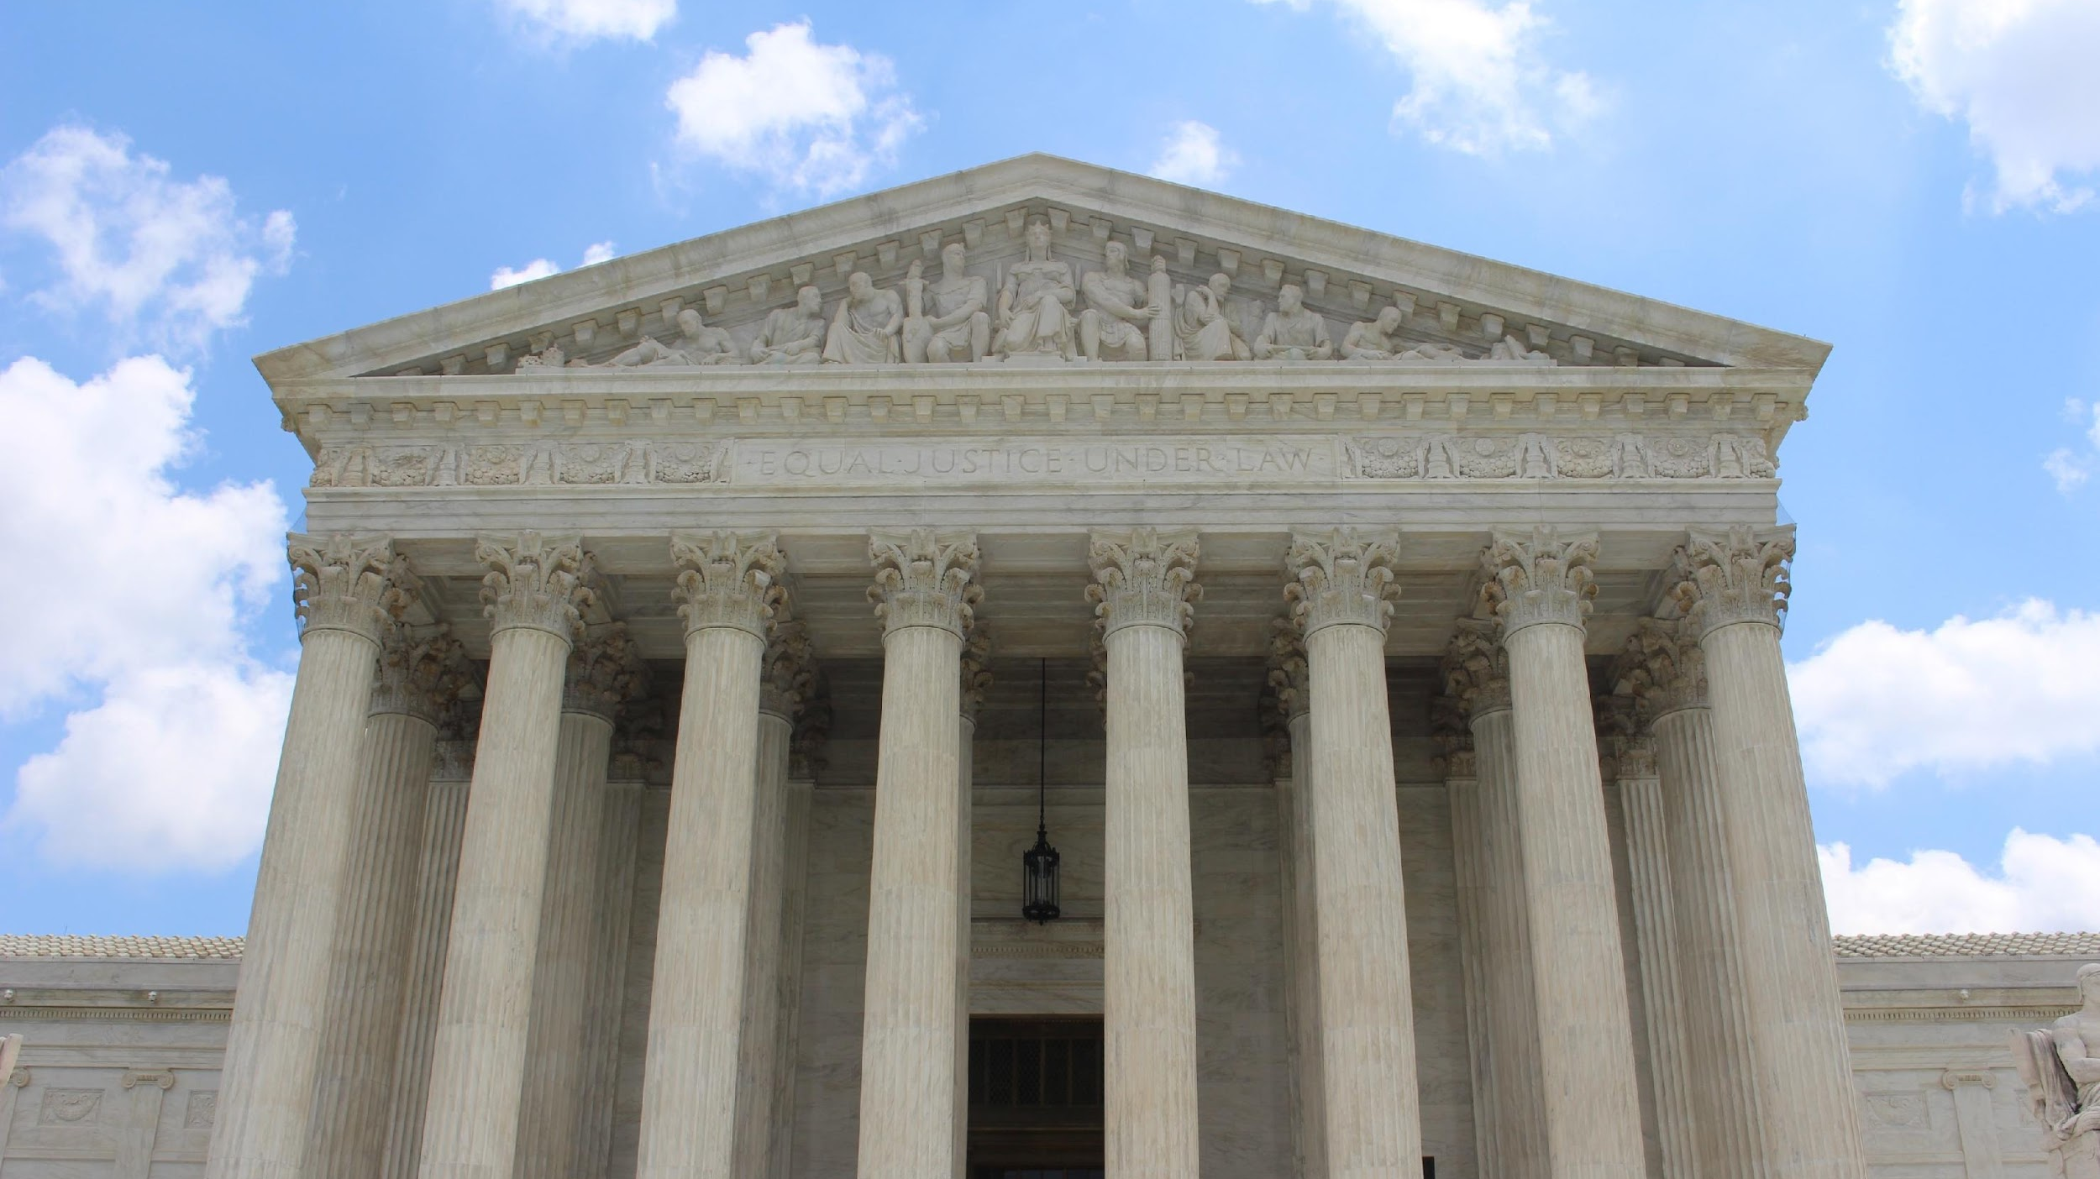
Prosecution
Phases of the Criminal Justice Process

Slide 23
Right to Participate: RC 2930.18, 2945.451
Victims cannot be fired or punished at work for:
  (1) participating in the preparation of the case at the prosecutor’s request; (2) attending a hearing pursuant to a subpoena to protect the victim’s interests; or (3) attending court pursuant to victims’ rights.
Punishment for violations by employers:
  Contempt of court

Slide 24
Right to Representative: RC 2930.02
Victims can choose one representative to exercise all rights in RC 2930.
Representatives can either:
  Offenders cannot be victim representatives
  If more than one person seeks to be representative, the court decides
  Exercise rights instead of victims OR
  Exercise rights along with victims

Slide 25
Right to Representative: RC 2930.02
Courts may appoint representatives
Representatives who are not acting in victims’ interest may be removed and replaced
  If a victim is incapacitated, incompetent, or deceased, and no one comes forward to act as rep, the court may appoint an advocate or other person
  A prosecution-based advocate cannot be appointed unless the prosecutor consents
  Prosecutor or court can initiate removal
  Must make a showing by preponderance of evidence
  Court may replace a representative with an advocate or other appropriate person

Slide 26
Right to be Informed: RC 2930.06
Within a reasonable time following the start of the prosecution, prosecutor must provide the victim a VRR form and inform the victim of:
  Name of criminal offense and defendant
  File/case number
  An explanation of CJP and right to be present
  Summary of rights
  Procedures if victim is threatened
  Contact info for prosecutor office

Slide 27


Right to Confer: Ohio Const., art. I, § 10a(A)(9) and RC 2930.06
On request, prosecutors must confer:
Before dismissing or amending the indictment
Before agreeing to a plea
Before trial or adjudicatory hearing
Before pre-trial diversion is granted
If a hearing involves any of the above and the VRR form indicates a victim requested to confer, the court will ask whether the prosecutor complied. If the court finds reasonable efforts to confer were not made or reasonable efforts to notify of the hearing were not made, court shall not rule on any substantive issue that implicates victims’ rights, accept a plea, or impose a sentence, and must continue the hearing.

Slide 28
Right to Notice and Presence: Ohio Constitution, Article I, Section 10a(A)(2)
Marsy’s Law provides victims the right to reasonable and timely notice of all public proceedings, upon request and the right to be present at those proceedings.

Slide 29
Right to be Heard: Ohio Constitution, Article I, Section 10a(A)(3)
Marsy’s Law provides victims with the right to be heard in any public proceeding involving release, plea, sentencing, disposition, parole, OR any time a victim’s right is implicated.

Slide 30
Case Law Spotlight
Right to Notice, Presence, and Opportunity to be Heard
  The Eighth District Court of Appeals held that a trial court must reopen sentencing after a victim was not notified of the hearing and was, therefore, unable to be present, heard, and seek restitution.
    City of Cleveland v. Rudolph, 2022-Ohio-2363, ¶ 1 (8th Dist.).

Slide 31

Delay: Ohio Constitution, Article I, Section 10a(A)(8)
Marsy’s Law provides victims with the right to proceedings free from unreasonable delay and a prompt conclusion of the case.

Slide 32
Delay: RC 2930.08
Courts should attempt to complete cases within Superintendence Rules’ timelines.
Victims have right to notice of delay. If the victim objects, the court may only grant a continuance for the time needed to serve the interests of justice.

Slide 33
Dismissed Counts: RC 2930.121
If a prosecutor dismisses one or more counts as a result of a negotiated plea, the victim may continue to exercise all rights as if the count was not dismissed.
The only exception is restitution. To exercise the right to restitution for a dismissed count, the prosecutor must include restitution for the victim in the terms of the plea.

Slide 34
Case Law
  State v. Anderson, 2025-Ohio-1226 (5th Dist.).
    Parents, children, and siblings of a deceased victim—dismissed homicide counts
    The Fifth District Court of Appeals held that the trial court’s determination that the “relatives were not victims was unreasonable and abuse of discretion” because “[i]t is foreseeable that a person’s family members would suffer emotional harm as a result of their death, and the emotional harm was produced by the natural and continuous sequence of events following” the defendant’s acts.
      Id. at ¶ 21.
    R.C. 2930.121 allows the parents, children, and siblings to still have the right to be heard at the sentencing hearing as victims, although the homicide counts were dismissed.
      Id. at ¶ 22.

Slide 35
Right to Privacy: Ohio Constitution, Article I, Section 10a(A)(6)
Except as authorized by Article I, Section 10 of Ohio’s Constitution, Marsy’s Law allows victims to refuse:
  Defense interview requests
  Defense deposition requests, and
  Defense discovery requests

Slide 36
Right to Privacy—Subpoenas of Victim Information: RC 2930.071-REPEALED AS OF 3/20/2025
If a defendant subpoenas victim information or records, the defendant must serve victim, victim counsel, and prosecutor.
Prosecutor shall provide defense the information needed to serve the victim.
In order to obtain victim records, the defendant has the burden of proving they are entitled to the records under a four-part test.
Even if the defendant meets that test, the court must still do an in camera review if the victim or prosecutor submits the records are privileged

Slide 37
Case law
  State v. Kelley, 2024-Ohio-157 (8th Dist.).
    Holding that the trial court did not err when it refused to conduct an in camera inspection of a victim’s medical records following a defendant’s failure to make a proper showing of entitlement to in camera review.
  State v. Kriwinsky, 2024-Ohio-2690 (8th Dist.).
    Holding it was not error for a trial court to review a victim’s counseling records in camera when the victim’s counsel agreed to in camera review.

Slide 38
Case law
State v. Counts, 2022-Ohio-3666 (8th Dist.).
  Trial court reversed for failure to properly consider a victim’s state and federal constitutional rights when ordering a defendant may access a victim’s home.
State v. Gronbeck, 2024-Ohio-26 (2nd Dist.).
  Victim’s appeal of trial court’s in camera review of privileged records was premature.
State v. O’Neill, 2025-Ohio-287 (12th Dist.).
  Defendant’s constitutional rights did not outweigh victim’s constitutional rights as to allow defendant access to victim’s privileged mental health records.

Slide 39
What does the repeal mean for cases going forward?
How will courts decide cases now that R.C. 2930.071 has been repealed?
State v. Counts, 2022-Ohio-3666 (8th Dist.).
  Trial court reversed for failure to properly consider a victim’s state and federal constitutional rights when ordering a defendant may access a victim’s home.
Nixon Test

Slide 40
Rights to Privacy and Safety—Testimonial Alternatives
The Revised Code provides special protections to:
  Child victims
  Victims with developmental disabilities
Prosecutors, victims, or victim counsel can file motions to allow these victims to testify via videotaped deposition or closed-circuit testimony. For some victims, the request must be granted. For all other victims, the court may grant the request on a showing that live testimony will cause emotional harm.
  RC 2937.11; 2945.481, 2945.482, 2945.49, 2945.491, 2152.81, 2152.811

Slide 41
Case law
State v. Wallace, 2024-Ohio-4955 (12th Dist.).
  Child victims of certain violent and sex crimes who are under age 13 are entitled to automatic testimonial accommodations upon request.

Slide 42
Right to Fairness and Respect for Safety, Dignity, and Privacy—Certain Victims and Witnesses: RC 2945.483
In any proceeding in which a child or person with a developmental disability testifies in open court, the victim or witness has the right:
  to be asked questions in a way they understand
  to be free from harassment or intimidation
  to have an advocate or rep present and within their field of vision UNLESS that person is removed for not acting in the interests of the victim
  to adjustments to room to ensure comfort and protection
  to have flexibility in formality to ensure comfort and protection
  to a comfort item with the person
  to use of screen so that victim or witness does not see defendant
  to a secure and comfortable waiting area with support person
  to have advocate or victim rep inform court of victim needs

Slide 43
Right to Fairness and Respect for Safety, Dignity, and Privacy—Certain Victims and Witnesses: RC 2945.483
Child victims and witnesses and victims and witnesses with developmental disabilities also have the right to have standby counsel appointed to question them instead of a pro se defendant if a court finds the person would suffer serious emotional trauma if questioned by the pro se defendant.

Slide 44
Right to Fairness and Respect for Safety, Dignity, and Privacy—Certain Victims and Witnesses: RC 2945.483
If any attorney or party affiliated with the case discloses identifying information of a child victim or witness, they may be punished with contempt.

Slide 45
Right to Safety: RC 2930.10
Victims and offenders should be given separate waiting areas in the courthouse.

Slide 46

Post-Conviction
Phases of the Criminal Justice Process

Slide 47
Right to Notice: RC 2930.12
Within seven days, victims must be notified of:
  Acquittal or conviction for each offense
  Purpose of pre-sentence investigation (PSI) and right to view PSI
  Contact info for probation officer conducting PSI
  Sentence imposed and subsequent modifications
    Including right to file restitution lien, if applicable
  Right to make victim impact statement (VIS)
    VIS may be disclosed to defendant

Slide 48
VRR Form Process Cont’d
If a defendant is convicted and sentenced to incarceration, the court must ask the victim if the victim wishes to update the VRR form.

Slide 49
Right to View PSI: RC 2930.131
If a PSI is available to the defense, the prosecutor must also be given a copy.
The prosecutor must forward a copy to the victim and representative.
If any portion of the PSI is redacted, the court must explain this on the record.

Slide 50
PSIs
State v. Evans, 2024-Ohio-5996 (10th Dist.)
  Victim’s failure to object to failure to provide PSI during sentencing hearing waived victim’s right to access.

Slide 51
Right to be Heard: Ohio Constitution, Article I, Section 10a(A)(3) & RC 2930.14
Victims have the right to make an oral or written (or both) impact statement prior to sentencing.
VIS are confidential, but defendants can view copies of written VIS.
If a victim raises new material info, the court must continue the hearing to give the defendant the chance to respond.
Victim impact statements ARE NOT subject to cross examination.

Slide 52
Case law
State v. Wilt, 2021-Ohio-3590 (7th Dist.).
  Holding that the trial court did not err or violate the Confrontation Clause when it permitted the victim to testify during the sentencing hearing because it reasoned that (1) Marsy’s Law permits victims to testify at sentencing hearings, (2) the defendant was able to speak after the victim, and (3) the Confrontation Clause does not apply to a sentencing.

Slide 53
Right to Restitution
Ohio Constitution, Article I, Section 10a(A)(7):
  Full and timely restitution from the person who committed the criminal offense or delinquent act against the victim.

Slide 54
Right to Restitution: RC 2152.20, RC 2152.203, RC 2929.18, RC 2929.28, RC 2929.281
Examples of compensable losses include, but are not limited to:
  Full or partial payment for the value of stolen or damaged property. The value of stolen or damaged property shall be the replacement cost of the property or the actual cost of repairing the property when repair is possible.
  Medical expenses;
  Mental health counseling expenses;
  Wages or profits lost due to injury or harm to the victim as determined by the court. Lost wages include commission income as well as base wages. Commission income shall be established by evidence of commission income during the twelve-month period prior to the date of the delinquent act for which restitution is being ordered, unless good cause for a shorter time period is shown.
  Expenses related to making a vehicle or residence accessible to the victim if the victim is partially permanently disabled or totally permanently disabled as a direct result of the delinquent act.

Slide 55
Right to Restitution: RC 2152.20, RC 2152.203, RC 2929.18, RC 2929.28, RC 2929.281
Court must order full restitution that is proven by a preponderance of evidence.
An offender’s tax return can be seized to pay restitution.
A restitution order does not expire until paid in full.
Upon termination of court’s jurisdiction in juvenile court, the restitution order becomes an automatic civil judgment for the victim, at no cost to the victim.
  For other courts, victims can obtain the civil certificate of judgment from the clerk of court at no charge.

Slide 56
Case Law Spotlight
Victims have a constitutional right to restitution from juvenile offenders, but listing all victims may be required in an appellate matter.
The Sixth District Court of Appeals stated the trial court erred in dismissing restitution as a civil matter and reversed and remanded the case for a restitution hearing. However, the ruling applied only to the minor child because the Sixth District determined the rights of the minor child and the non-appealing parties (parents) are not so interwoven or dependent on each other to require a reversal as to the trial court’s entire judgment.
  The Court noted that the father mentioned his previous mental health concerns and mother brought up how the juvenile offender’s conduct brought up memories of her own childhood abuse.
  In re C.W., 2025-Ohio-262 (6th Dist.).

Slide 57
Case law
Are attorney fees an improper basis for a restitution order? It depends.
The First District Court of Appeals reversed the trial court’s restitution order that included attorney fees. The First District held that the economic loss suffered by the victim is not a direct and proximate result of the commission of the offense, but rather a consequential cost incurred subsequent to the offense
  State v. Nelson, 2024-Ohio-1773 (1st Dist.).
The Eleventh District Court of Appeals affirmed the trial’s court order of restitution for legal services. The Eleventh District held “the victim’s expenses were not incurred to advance her claim, but to ameliorate the effects of Appellant’s conduct.
  State v. Smith, 2023-Ohio-126, ¶ 31 (11th Dist.).

Slide 58
Case Law Spotlight
A tattoo to cover a scar from an assault is a reasonable option.
The Eighth District Court of Appeals affirmed the trial court’s restitution order that included a $500 estimate from a tattoo artist. The Eighth District held that the victim electing a tattoo over the recommended skin-graft procedure does not require a different result. It is evident from the record that appellant caused the victim to suffer an economic loss or detriment, which was a foreseeable consequence of the assault offense.
  State v. Mitchell, 2023-Ohio-4648 (8th Dist.).

Slide 59
Case law
Is a defendant’s inability to pay relevant when it comes to restitution?
Ohio appeals courts have held that under Marsy’s Law, the trial court is not required to consider the defendant’s inability to pay before ordering restitution.
  State v. Radabaugh, 2024-Ohio-5640 (3d Dist.).
  State v. Penty, 2024-Ohio-5397 (10th Dist.).
  State v. Williams, 2024-Ohio-5092 (8th Dist.).
  State v. Oliver, 2021-Ohio-2543 (12th Dist.).

Slide 60
Case Law Spotlight
Full and Timely Restitution
The Ohio Supreme Court has stated “ ‘full and timely restitution’ is still ‘restitution;’ it is simply restitution that is completely accomplished in a prompt manner.”
  State v. Yerkey, 2022-Ohio-4298, ¶ 14.

Slide 61
Case Law Spotlight
A trial court cannot defer a restitution order until the defendant finishes their prison term.
The Tenth District Court of Appeals held deferring restitution at sentencing due to a defendant's impending incarceration is unconstitutional.
Notably, the Tenth said of enforcement of the order: “As to a victim's method of successfully enforcing his or her right to the timely payment of restitution from an indigent defendant who is incarcerated, we ungrudgingly leave the task of figuring out how Marsy's Law supposes to force blood from a stone, within the confines of the law, for someone else on another day.”
    State v. Scott, 2024-Ohio-2274 (10th Dist.).

Slide 62
Case Law Spotlight
A victim is entitled to interest on restitution judgments.
The Fifth District stated the statutory provisions allow a victim with a restitution order to obtain a civil certificate of judgment and be allowed to have civil remedies without having to file a separate civil action. Furthermore, the statutory authority and case law does not exempt a restitution judgment creditor from the interest provisions of R.C. 1343.03.
  State v. Kettering, 2025-Ohio-54 (5th Dist.).

Slide 63
More Lessons from Right to Restitution Case Law
State v. Oliver, 2021-Ohio-2543 (12th Dist.).
  Holding that whether a defendant is unable to pay the amount of restitution is irrelevant under Marsy’s Law because it supersedes the offender’s right under R.C. 2929.19(B)(5) to the extent the statute allows the trial court to reduce or otherwise modify the restitution amount owed to a victim.
  Holding that a trial court is permitted to consider the state’s recommendation for a restitution amount, but is not bound by such recommendation and may consider other factors if the restitution amount is not a conduction of any plea agreement.
State v. Langston, 2024-Ohio-5069 (5th Dist.).
  A trial court’s failure to journalize a restitution hearing in the sentencing entry invalidated its order of restitution to the victims.

Slide 64
More Lessons from Restitution Case Law
State v. Yerkey, 2020-Ohio-4822.
  Holding that lost wages due to attendance at court proceedings furthering prosecution of the criminal offense do not “flow as a natural and continuous consequence from the commission of the offense, such that they may be considered economic loss suffered by the victim.” Id. at ¶ 16.
State v. Brandenburg, 2024-Ohio-5943 (2nd Dist.).
  A victim’s failure to specifically request restitution from the trial court waived their right to restitution.
State v. Dixon, 2025-Ohio-326 (3rd Dist.).
  A victim’s right to restitution does not attach until after conviction.
In re C.W., 2025-Ohio-262 (6th Dist.).
  A trial court erred in stating that restitution is a civil matter and refusing to award restitution to a child victim in a juvenile matter.

Slide 65
Right to Notice: Ohio Constitution, Article I, Section 10a(A)(5)
Under Marsy’s Law, upon request, victims are entitled to notice of any release or escape of the offender.

Slide 66
Who provides notice? RC 2930.01(B)
(B) "Custodial agency" means one of the following:
(1) The entity that has custody of a defendant or an alleged juvenile offender who is incarcerated for a criminal offense, is under detention for the commission of a delinquent act, or who is detained after a finding of incompetence to stand trial or not guilty by reason of insanity relative to a criminal offense, including any of the following:
(a) The department of rehabilitation and correction or the adult parole authority;
(b) A county sheriff;

Slide 67
Who provides notice? RC 2930.01(B)
(c) The entity that administers a jail, as defined in section 2929.01 of the Revised Code;
(d) The entity that administers a community-based correctional facility and program or a district community-based correctional facility and program;
(e) The department of mental health and addiction services or other entity to which a defendant found incompetent to stand trial or not guilty by reason of insanity is committed.
(2) The entity that has custody of an alleged juvenile offender pursuant to an order of disposition of a juvenile court, including the department of youth services or a school, camp, institution, or other facility operated for the care of delinquent children.

Slide 68
Right to Notice: RC 2930.16
Upon request, prosecutors must notify victims of:
  Incarceration and release date of offenders
  Information on Ohio Department of Rehabilitation and Correction (DRC) or Ohio Department of Youth Services (DYS) Office of Victims’ Services
  Hearings on judicial release
    If judicial release is being considered, the court must inform the prosecutor at least seven days before the hearing.
    The prosecutor must then notify the victim and representative of the hearing, and the right to be present and heard.

Slide 69
Victims’ Rights Request Form Process: RC 2930.16
On first contact with a victim, the custodial agency must verify the victims’ choices in the VRR form.
If no VRR form was transmitted to the custodial agency, it must send one to the victim.
Any victim by virtue of being directly and proximately harmed by an offense must identify themselves to the custodial agency.

Slide 70
Right to Notice and to be Heard: RC 2930.16
Victims of violent felony offenses of the 1st, 2nd, or 3rd degree** will automatically receive the following notifications from DRC or DYS at least 60 days in advance:
  Pardon or commutation
  Parole, including an opportunity to attend parole board hearing and make a statement prior to parole
  Transfer to transitional control
  **Other victims MUST REQUEST these notices
  These victims also have the right to attend victim conferences with at least three victim family members to discuss the case privately with DRC.

Slide 71
Right to Notice: RC 2930.16
In addition, victims of violent felony offenses of the 1st, 2nd, or 3rd degree** will receive notice of:
  Escape and recapture within three days
  Death within 30 days
  DRC petition for early release within 30 days
  **Other victims MUST REQUEST these notices

Slide 72
Right to Notice: RC 2930.162
Before the governor grants pardon, commutation, or reprieve for an offense of violence, the governor’s office shall notify victim, representative, and victim counsel of the application for pardon, commutation, or reprieve at least 30 days before issuing decision.
Victim and representative may submit a written statement and must be informed of this right.

Slide 73
Right to be Present and Heard: RC 2930.17
When determining whether to grant judicial release, a court shall allow victim and representative to be heard orally, in writing or both.
Defendant may review a copy of the statement and DRC/DYS shall receive a copy.
The court must consider any victim’s and representative’s statement.
If the court orders release, it shall notify the prosecutor promptly and shall send its journal entry to the custodial agency BEFORE release.

Slide 74
Right to Safety: VINE
Advocates or prosecutors should talk to victims about VINE (Victim Information and Notification Everyday—vinelink.com) to track incarcerated offenders.

Slide 75
Right to Safety, Right to be Present and Heard: RC 2930.161
On request of victim or representative who provided contact information, a court must provide notice of:
  Probation termination hearing
  Probation modification hearing
  Arrest for any probation violation
  Failure to complete diversion

Slide 76
Right to Safety, Right to be Present and Heard: RC 2930.161
On request of victim or representative who provided contact information, probation must provide notice of the following, as soon as it becomes known to probation:
  Any proposed modification of probation that impacts restitution, detention status, or victim safety
  Victim’s right to be heard at any probation hearing
  The violation that led to any revocation hearing
  Following a risk assessment, any probation terms, including restricted locations, and other conditions impacting victim safety

Slide 77
Case Law Spotlight
Right to Notice
The Eighth District Court of Appeals held that a trial court must notify a victim of a probation or community control revocation disposition proceeding or any proceeding in which the court is asked to terminate the probation or community control.
  State v. Malfregeot, 2024-Ohio-257, ¶ 11 (8th Dist.).
  See also, State v. Gaiters, 2025-Ohio-30 (5th Dist.).

Slide 78
Right to be Present and Heard: Sealing and Expungement of Records
A court must notify the prosecutor 60 days before** any hearing to seal or expunge records.
The prosecutor shall provide timely notice to victim and representative if the victim requested notice and kept their contact information updated.
The court must allow the victim, representative, and victim counsel to attend and make a statement orally, in writing, or both.
Defendant may review written statement.
Court shall give APA/DYS a copy.
Court shall consider victim statement.
Upon decision, court shall promptly notify prosecutor and prosecutor shall promptly notify victim and representative.
**Notice is 30 days before hearing for juvenile cases

Slide 79
Case Law Spotlight
A hearing is required with adequate notice.
The Eighth District Court of Appeals stated, “[t]he express purpose of the timing requirements is to permit the State, as required under the Ohio Constitution, to timely notify any victim impacted by the sealing of the record.”
  State v. A.M., 2025-Ohio-647, ¶ 4 (8th Dist.).

Slide 80
Where do victims’ rights apply?

Slide 81
Ohio Const., art. I, § 10a(B)
(B) The victim, the attorney for the government upon request of the victim, or the victim's other lawful representative, in any proceeding involving the criminal offense or delinquent act against the victim or in which the victim's rights are implicated, may assert the rights enumerated in this section and any other right afforded to the victim by law. If the relief sought is denied, the victim or the victim's lawful representative may petition the court of appeals for the applicable district, which shall promptly consider and decide the petition.

Slide 82
Case Law Spotlight
Civil applications
Victims’ rights can be applied in civil protection order proceedings.
  S.D. v. S.L., 2023-Ohio-4575 (6th Dist.).
Applications for relief from firearms disability
  State ex rel. Suwalski v. Peeler, 2020-Ohio-3233.
    Victims have standing to assert their rights to safety and reasonable protection in proceedings seeking removal of firearms disabilities.
    A state trial court lacks jurisdictional power to remove a federal firearms disability.

Slide 83
Case Law Spotlight
Civil applications
State medical board proceedings
  Doe v. State Med. Bd., 2024-Ohio-5615 (10th Dist.).
    Victim had standing to assert the right to refuse a defense interview request in a state medical board proceeding.
  Domestic relations proceedings
    In re J.S., 2024-Ohio-4887, ¶ 79 (1st Dist.) (Kinsley, J., dissenting).
      The practice of separating children from a parent who experiences domestic violence is “in tension with Ohio's constitutional protections for victims, enshrined in Marsy's Law, which requires that victims be treated with fairness and respect.”

Slide 84
How does a victim exercise their rights?

Slide 85
Ohio Constitution, Article I, Section 10a(B)
Pro se
Through counsel
Through representative (being mindful of prohibition on unauthorized practice of law)
Through the prosecutor, upon request

Slide 86
Who can assert victims’ rights? And how?
State v. Kidd, 2021-Ohio-503 (8th Dist.).
  Holding that defendant did not have standing to challenge whether a warrant violated the victim’s rights under Marsy’s Law.
State v. Allen, 2024-Ohio-5386 (4th Dist.).
  A state appeal challenging violations of victims’ rights to be notified, present, and heard at sentencing dismissed for failure to file motion for leave to appeal.
State v. Back, 2024-Ohio-5569 (4th Dist.).
  A state appeal challenging violations of victims’ rights to be notified, present, and heard at sentencing dismissed for failure to file motion for leave to appeal.

Slide 87
Who can assert victims’ rights? And how?
State v. Fisk, 2022-Ohio-4435.
  Under the Ohio Constitution, the state has standing to assert victims’ rights on behalf of victims.
State v. Nbubueze, 2024-Ohio-1414 (12th Dist.).
  The state may only raise victims’ rights issues by right on appeal on behalf of the victim.

Slide 88
Right to petition: Appeals, writs, and more?
State ex rel. Thomas v. McGinty, 2020-Ohio-5452.
  Chief Justice Kennedy’s dissent
State v. Brasher, 2022-Ohio-4703.
  Victims must appeal rights violations at sentencing within 30 days of entry or waive their rights.

Slide 89




Don’t Forget About Us!
Refer a case!
https://www.ocvjc.org/request-for-assistance
Reach out for help!
info@ocvjc.org
Use the Toolkit!
Victimsrightstoolkit.org
Follow us on social media!
@OCVJusticeC

Slide 90

THANK YOU!

