Slide 2

Rights of Victims/Survivors Post-Conviction and Trauma-Informed Response
10th Annual Responding to the Needs of Victims Conference
Friday, October 3, 2025

Slide 3
OFFICE OF VICTIM SERVICES (ovs)
OVS MISSION
To provide crime victims meaningful participation in post-conviction processes through internal and external partnerships.
OVS VISION
To make a positive difference in the life of crime victims.

Slide 4
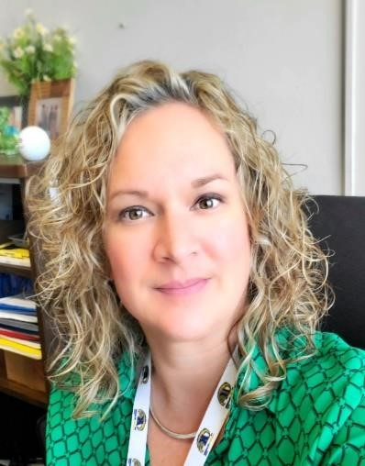
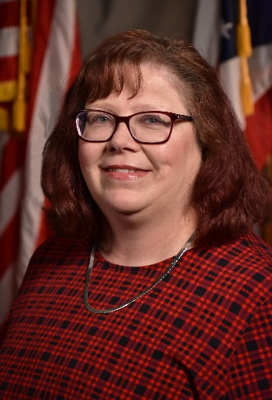
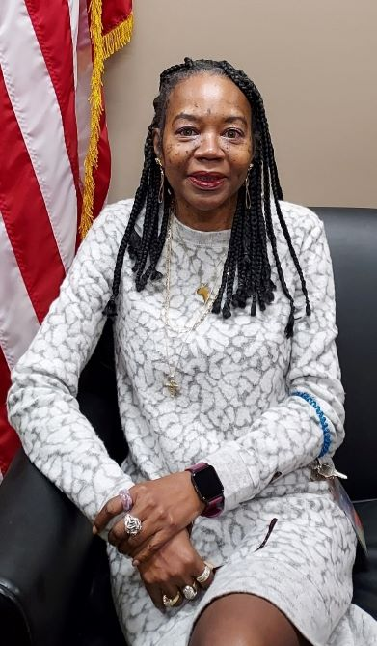
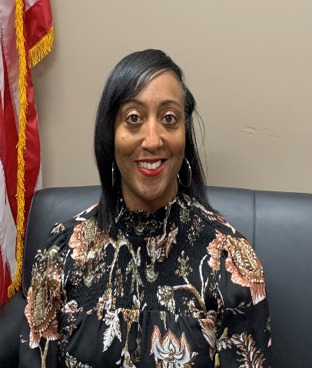
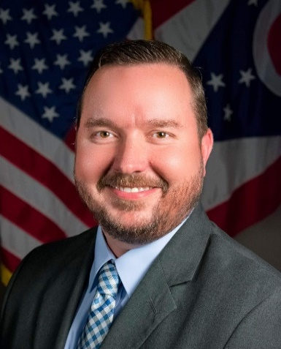
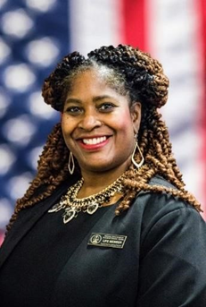


OVS Staff members
Kristen Arapp
Victim Advocate NE Region
Jennifer Conkle
Victim Advocate SE Region
Ghitana Mitchell
Administrative Professional
Aretha Gamble
Victim Advocate SW Region
Thomas J. King
Victim Advocate NW Region
Tracy Tyson-Parker
Asst. Administrator
Chrystal Pounds-Alexander
Administrator
Notes:
Jen

Slide 5
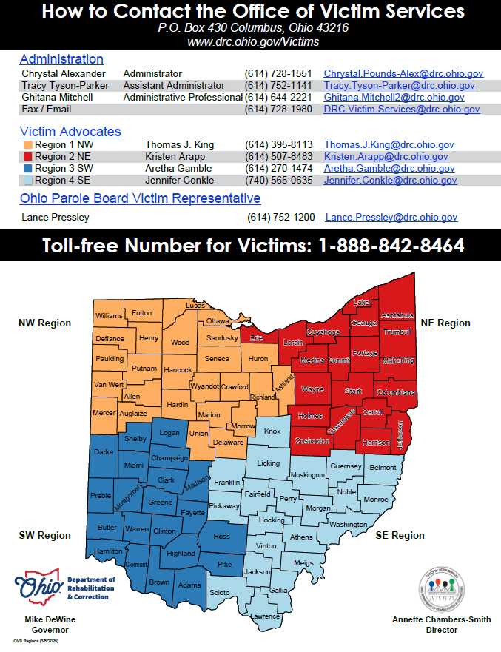
OVS Contact Information

Slide 6
Offenses of violence 2901.01(a)(9)
Aggravated murder
Murder
Voluntary manslaughter
Involuntary manslaughter
Felonious assault
Aggravated assault
Assault
Permitting child abuse
Strangulation
Aggravated menacing
Menacing by stalking
Menacing
Kidnapping
Abduction
Extortion
Trafficking in persons
Rape
Sexual battery
Gross sexual imposition
Aggravated arson
Arson
Terrorism
Aggravated robbery
Robbery
Aggravated burglary
Inciting to violence
Aggravated riot
Riot
Inducing panic
Swatting
Domestic violence
Intimidation
Intimidation of attorney, victim or witness in criminal case or delinquent child proceeding
Escape
Improperly discharging firearm
Patient abuse
Burglary
Endangering children where abuse, torture, excessive or unwarranted or knowingly, and involving physical harm to persons or a risk of serious physical harm to persons
A conspiracy or attempt to commit, or complicity in committing, any above offenses.
Notes:
Aretha

